Slide 1
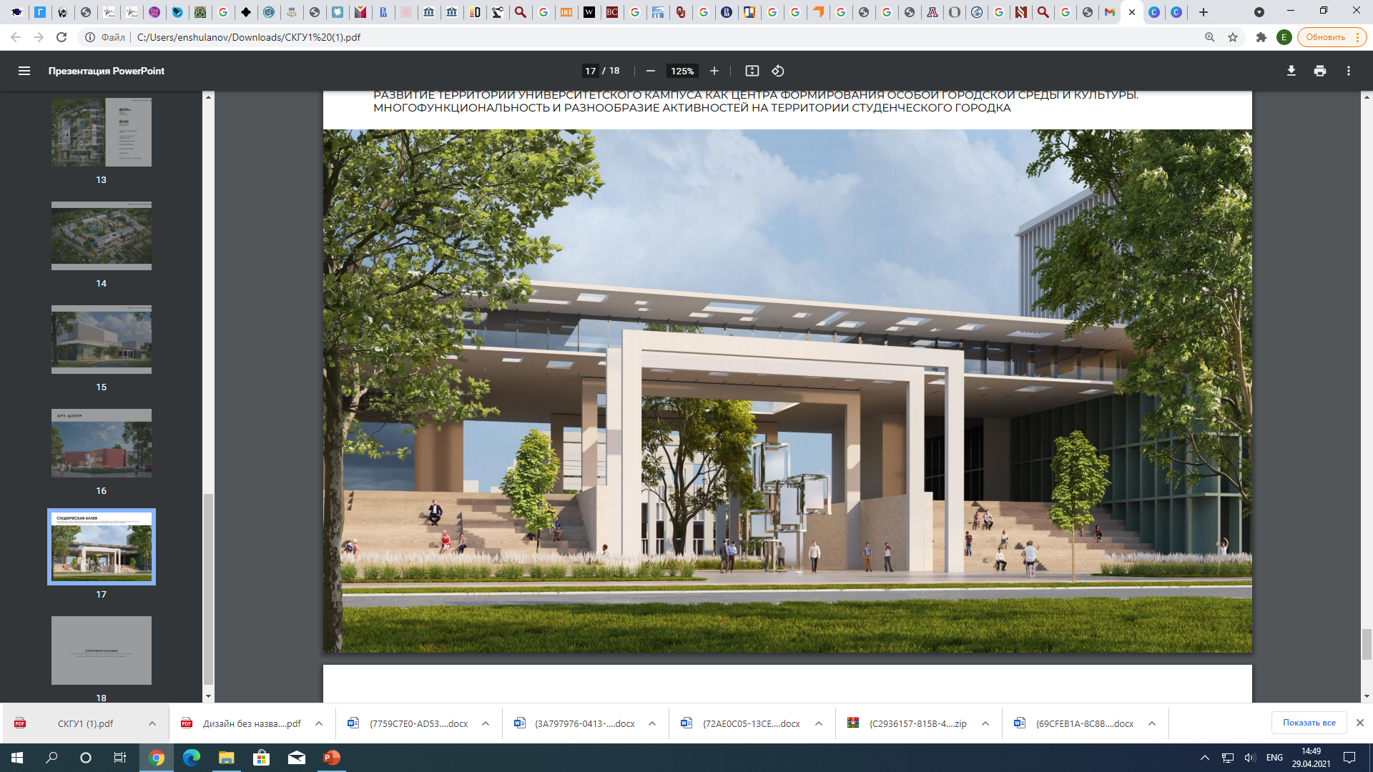
KOZYBAYEV UNIVERSITY & UNIVERSITY OF ARIZONA
Case of International Cooperation
Renata Apergenova,
PhD in Education

Slide 2

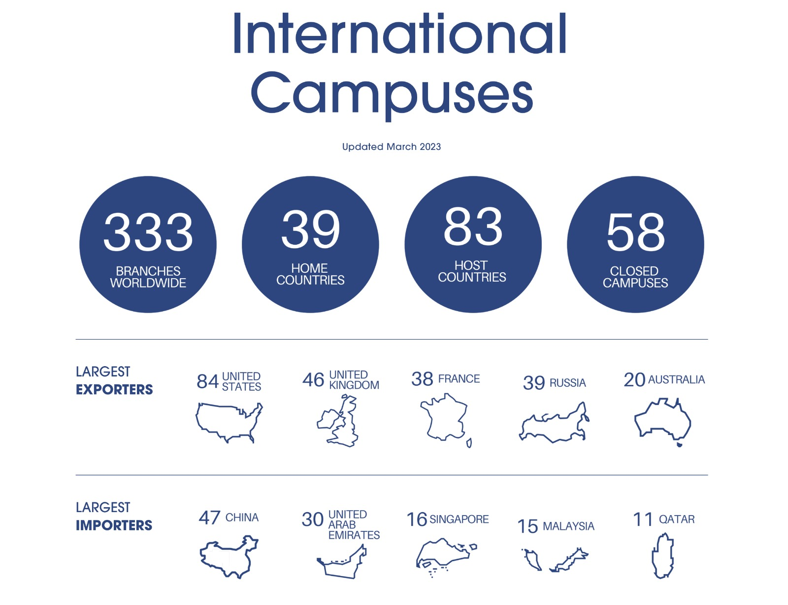
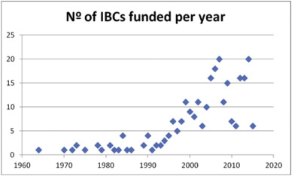
Модели сотрудничества с зарубежным вузом /
Models of cooperation with international universities
«Кампус» или «Бранч-кампус» / микрокампус // international branch campus (IBC) /microcampus
Совместные и двойные дипломы / Joint and double degree diplomas
Партнерские программы/Partnership programs
Стратегическое партнерство / Strategic partnership
Франчайзинговые соглашения / Franchise Agreements
Доверительное управление / Trust management
(Escriva-Beltran, Muñoz-de-Prat & Villó, 2019)

Slide 3
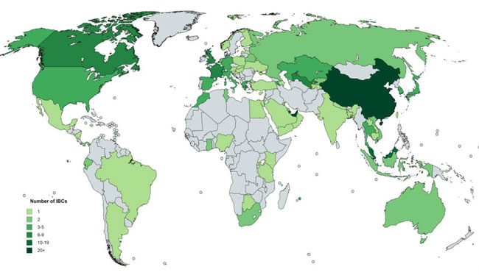
Number of IBCs by host country. Source: OBHE

Slide 4
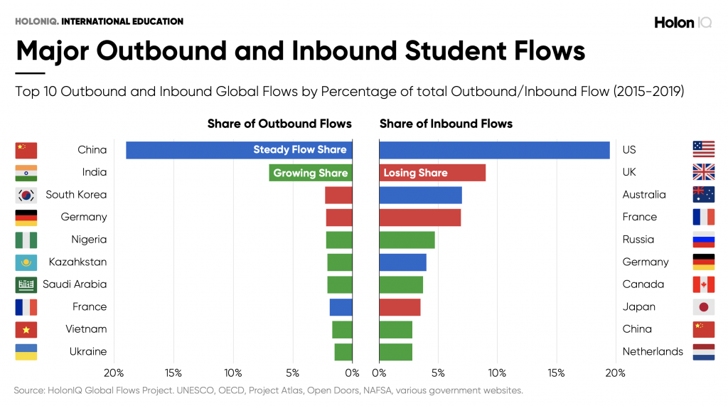

Slide 5

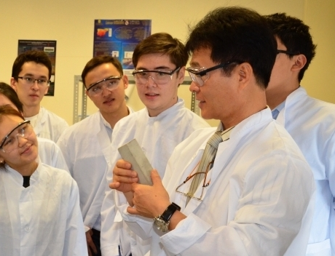

Conceptual framework
Academic process
MAIN APPROACH:
Academic programs are recognized by the partner-HEI
Study in 2 Universities
Language of study – English
Double diploma: Kazakh + international
Creation of universities of Excellence on the basis of existing regional universities with the involvement of a international leading partner
Faculty & students
International Faculty
The strongest regional scientists
Retaining talented students in regions
Attracting international students
(import of education)
ADVANTAGES:
Strengthening existing regional leading universities
Implementation of the principle of "serving to the region“
Creation of points of growth in the regions
Attracting investments to regional universities
Infrastructure:
Empowerment

Slide 6
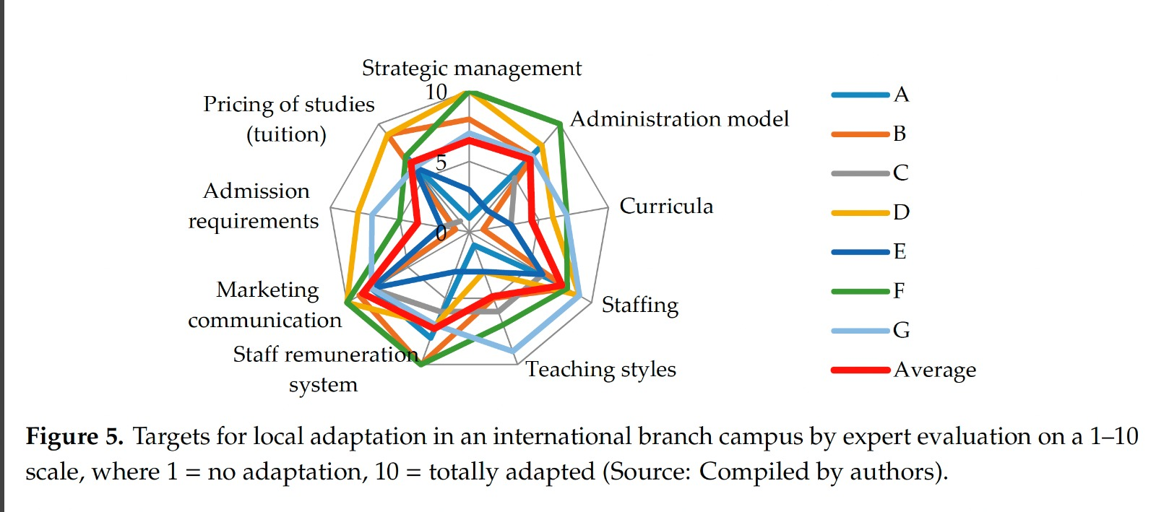
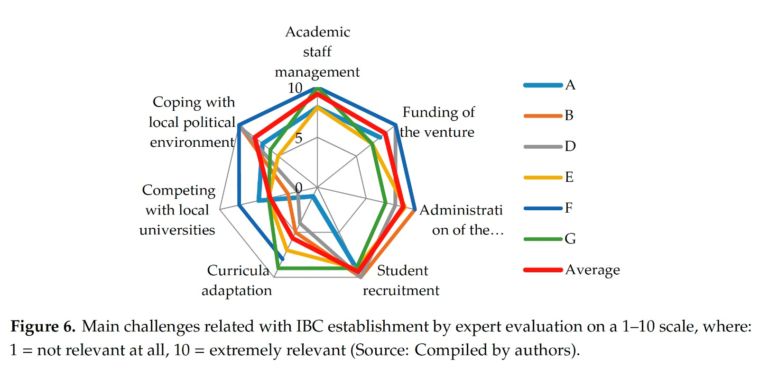
Компилирование мирового опыта /
World best practice compiling
ИНСТИТУЦИОНАЛЬНОЕ РАЗВИТИЕ / INSTITUTIONAL DEVELOPMENT:
1. ОТКРЫТИЕ КАМПУСОВ Университета Аризоны на базе вуза / OPENING THE CAMPUSES of University of Arizona on the basis of the university
2. АККРЕДИТОВАННЫЙ ДИПЛОМ УНИВЕРСИТЕТА АРИЗОНЫ с акцентом на инженерные, агротехнические направления / ACCREDITED DIPLOMA of THE UNIVERSITY OF ARIZONA with a focus on engineering, agrotechnical areas
3. ДОСТУП К ОБРАЗОВАТЕЛЬНЫМ РЕСУРСАМ АРИЗОНЫ: онлайн курсы, научные журналы и базы данных / ACCESS TO EDUCATIONAL RESOURCES IN ARIZONA: online courses, scientific journals and databases
4. ОБУЧЕНИЕ ПРЕПОДАВАТЕЛЕЙ И РАБОТНИКОВ мировым практикам / STAFF TRAINING based on the best international practice

Slide 7

Challenges in creating international academic programs
Legislation
Research potential
Increasing the level of English proficiency
Synchronization of academic policies and standards
Personnel potential

Slide 8
Thank you for your attention!
rsapergenova@ku.edu.kz
www.nku.edu.kz

